Slide 1

Posting to the Web

Slide 2
Posting Live Content
Thus far, all of our files have resided on local computers or servers, unavailable to the search engines and general public. To publish our site to the live internet, we will need several things:
A registered domain, such as mydomain.com.
A web hosting plan through a hosting provider.
A software program to transfer files back and forth between the local computer and the remote web server.
We will not actually publish any of our websites in this class, as it would cost money and would be beyond the scope of this introductory course. However, we will get a brief overview of the process.

Slide 3
Registering a Domain
Acquiring our own domain is a fairly straightforward process. The cost to register and maintain a domain is about $10 - $12 per year. Many domain extensions are available, but the most common are:
.com
.net
.us
Once we've settled on a domain (e.g. mynewdomain.com), we'll need to order and pay for it via a domain registrar. There are thousands of such registrars, but a few of the larger ones are:
GoDaddy.com
Namecheap.com
Name.com
Any domain registrar will let us conduct a search to verify that the domain we want is either available or already taken.

Slide 4
Choosing a Web Hosting Plan
The next step is to select a web hosting provider. This company will allow us to store our files on their web servers and will deliver our web content to anyone in the world that visits our website. Again, there are thousands of options, but some well-known web hosts are:
GoDaddy.com
HostGator.com
Bluehost.com
The cost for this service can vary widely, but the most affordable plans are generally in the $4 - $8 per month range.
Most web hosts will offer discounts if prepaying for one year. For example, GoDaddy offers one year of hosting, along with the first year of domain registration, for $60 total.
Once we have a domain registered and a web hosting plan set up, we need to configure the domain to point to the web host. The web hosting company will provide us with step-by-step instructions on how to complete this step.

Slide 5
Choosing FTP Software
Now that we have our own domain and it's mapped to our new web host, we'll need a way to transfer our website files from the local computer to the remote web server. We do this by using an FTP (File Transfer Protocol) program. Of the dozens available, these are free and easy to use:
FileZilla (Windows or Mac)
WinSCP (Windows)
CyberDuck (Windows or Mac)
Let's take a quick look at using one of these FTP programs to upload files to a live web server.

Slide 6
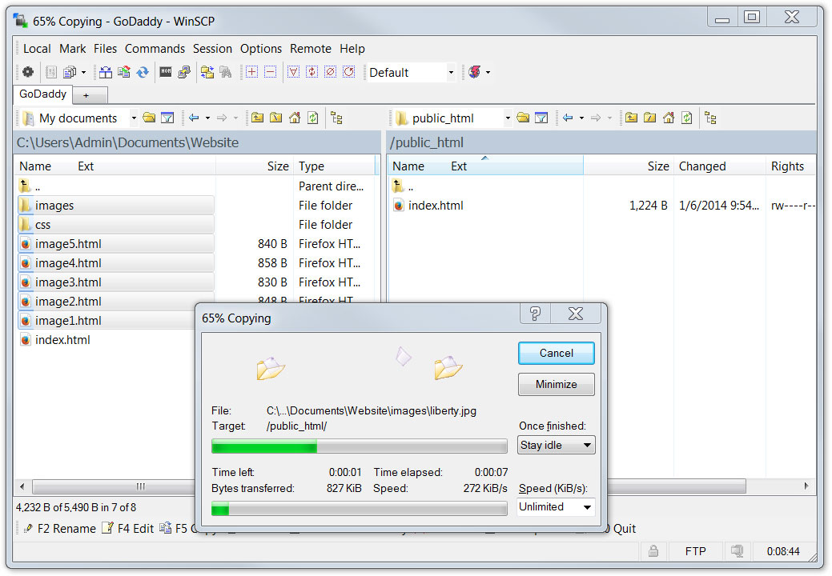
Transferring Web Files
Here, we are using WinSCP to upload files from our local PC to the root directory of the remote host:
This is a typical FTP program screen. Local files and folders are displayed on the left panel and remote (web host) files and folders are displayed on the right panel. We can click and drag files and folders back and forth between the two.
When someone visits our website using just the domain name, the file server will search for and deliver our home page, the index.html file.

